Slide 1
Setup and Timing
Setup:
https://arcade.makecode.com Home Page open in Edge (preferably Edgium)
Computer volume on 50
Meowbits passed out at the end of the session (during the Download section)
Timing (45):
Intro (5)
On Start (10)
On Game Update (10)
On Button Pressed (5)
On Overlap Player/Enemy (5)
On Overlap Projectile/Enemy (5)
Share and Download (5)
Close (0)

Slide 2
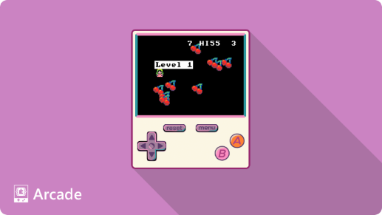
Microsoft MakeCode Arcade
Student Zone – Build It
Notes:
Introduce yourself

Slide 3
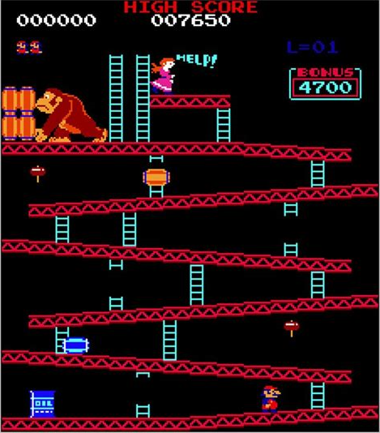
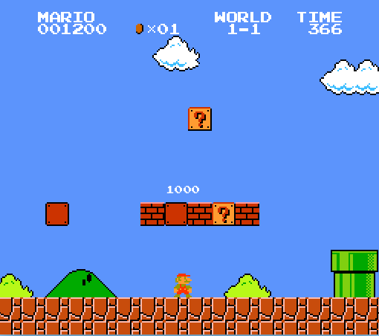
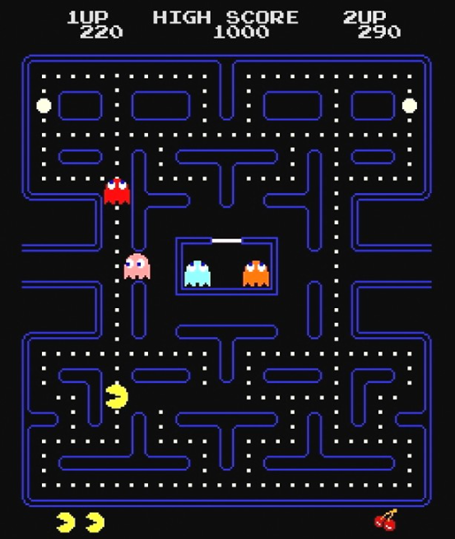
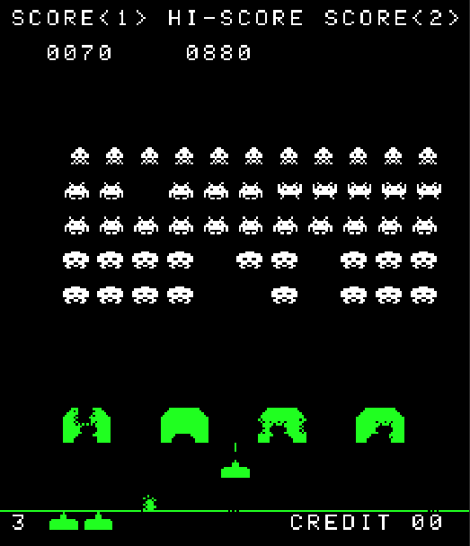
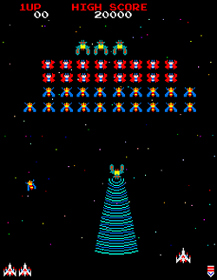
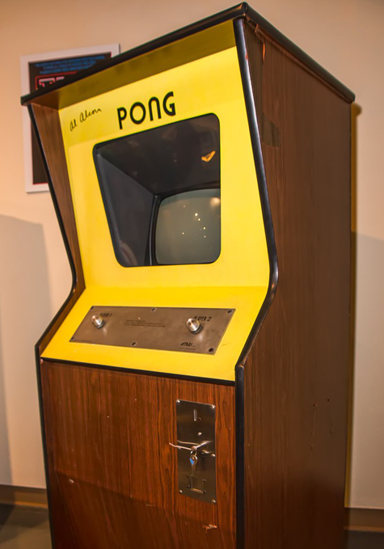
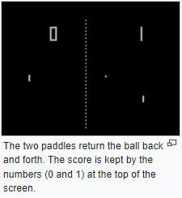
What are Arcade Games?
An arcade game is a coin-operated video game machine.
Arcade games rose to popularity in the 1970’s and 1980’s.
The first successful Arcade game was called Pong, created by Atari in 1972.

Slide 4
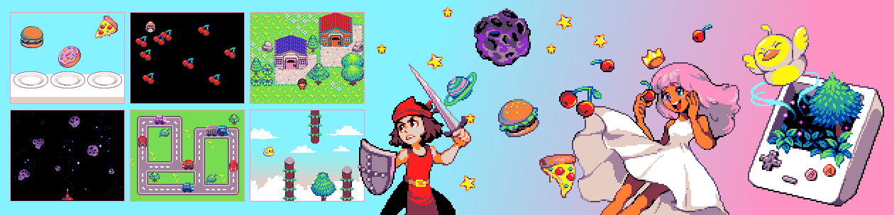
MakeCode Arcade
1980’s Retro Arcade Game Development Platform
2D Sprite-based games
Block and JavaScript code editors
Share and play others’ games
Multi-player support & Hardware!
What are Sprites?

Slide 5
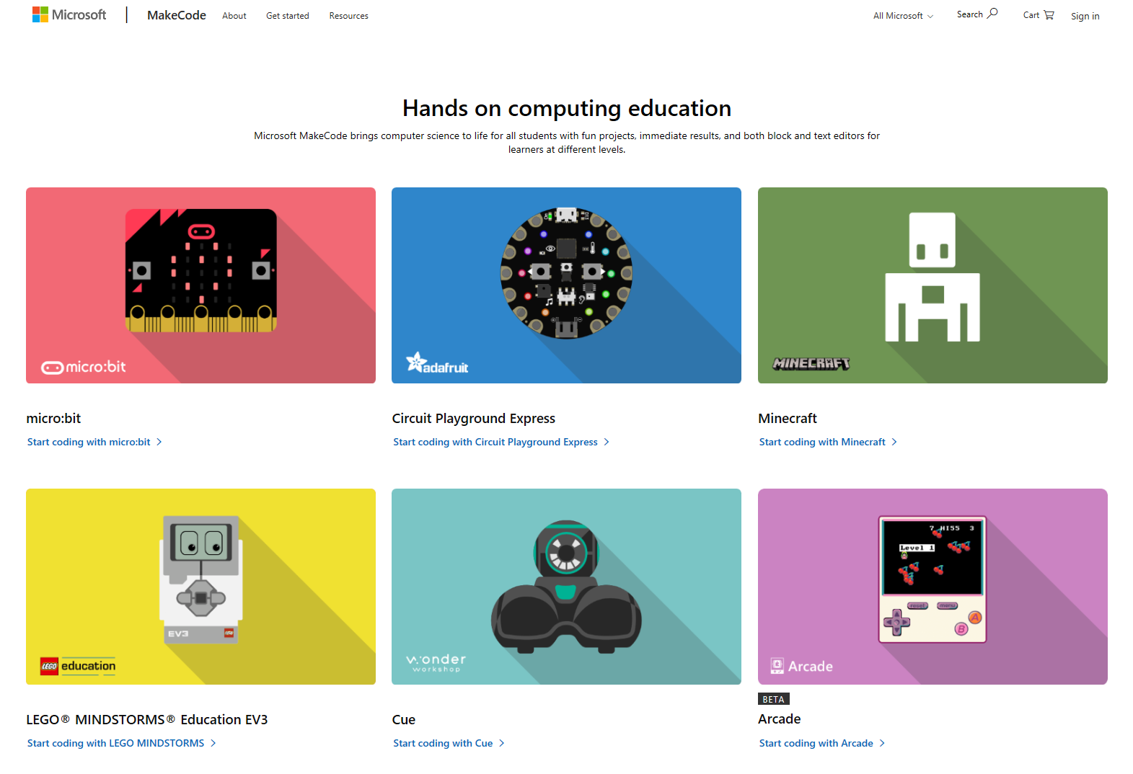
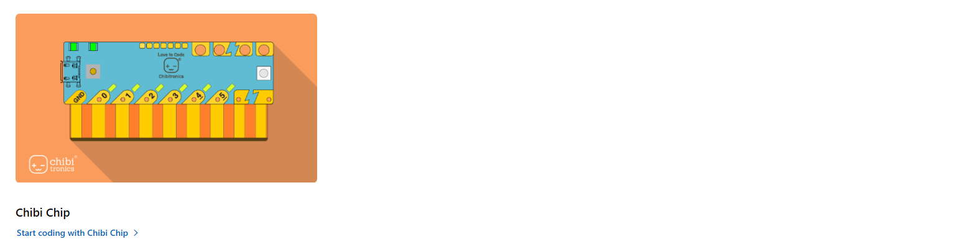
MakeCode.com
arcade.makecode.com

Slide 6
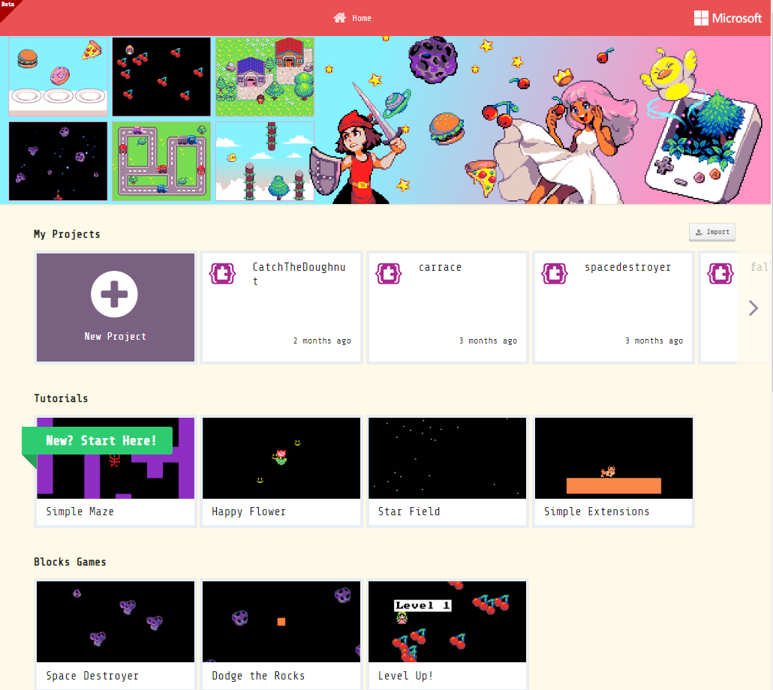
Getting familiar with MakeCode Arcade
Home Page
Import Projects (via a file or URL)
Create a New blank Project
Open your recent Projects
Step-by-step Tutorials
Game examples

Slide 7
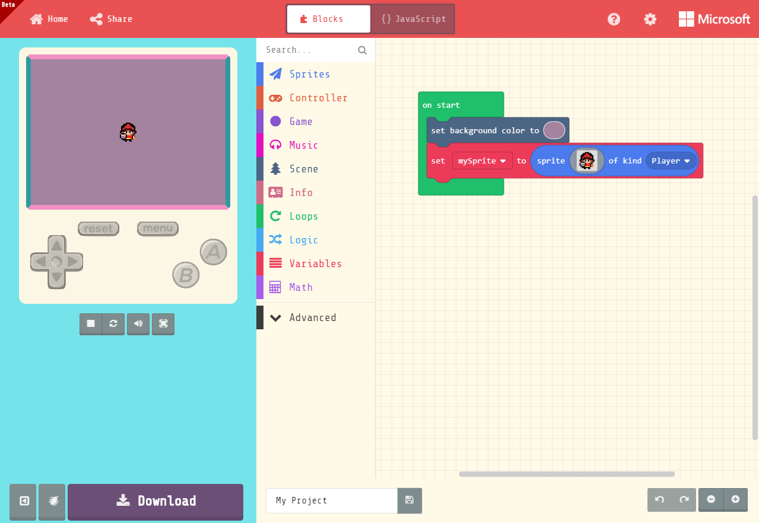
Getting familiar with MakeCode Arcade
Share game via URL
Game Simulator
shows what your game looks like
Switch between
Blocks & JavaScript
Game controls hover mouse to activate
Coding
Workspace
Simulator Toolbar
Stop
Restart
Mute
Full screen
Block Toolbox
Name and Save game to a file
Debugger

Slide 8
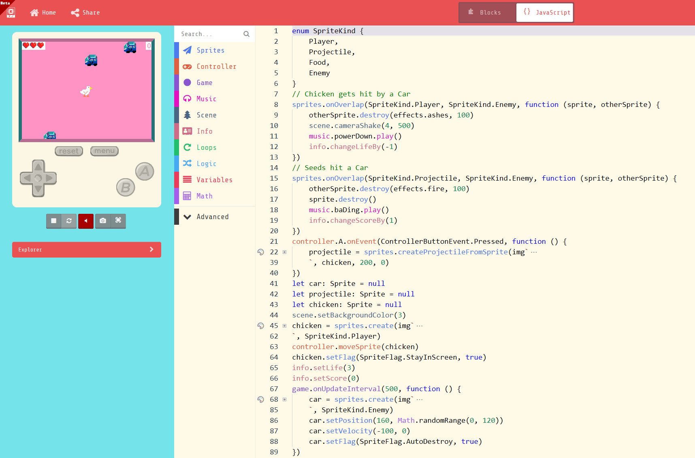
JavaScript

Slide 9
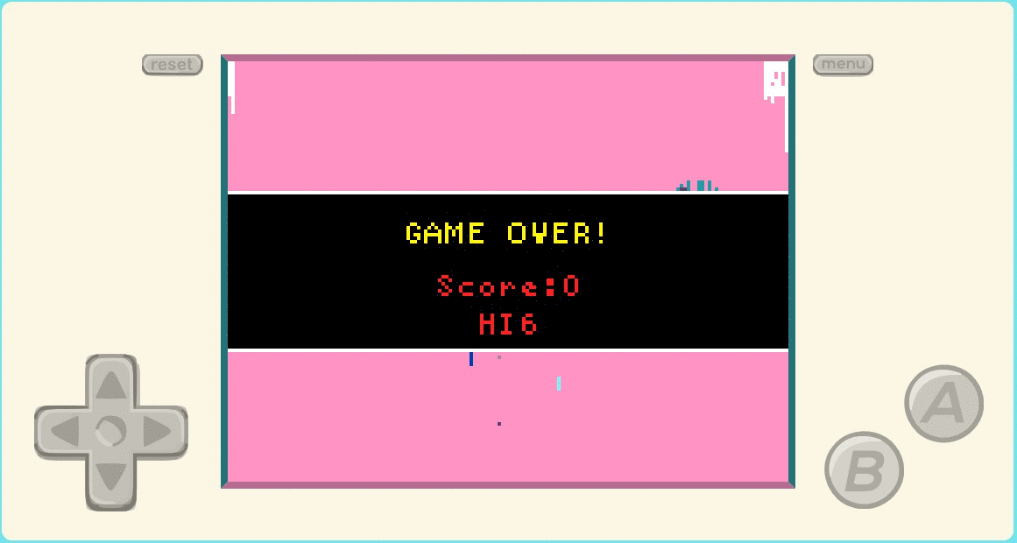
Create your first game
Why did the Chicken cross the Road?
Move your sprite around the screen, avoid cars and spit seeds!

Slide 10
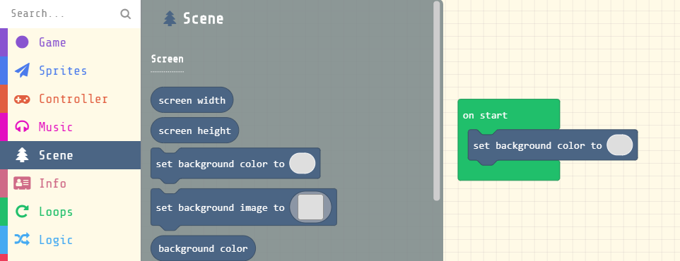
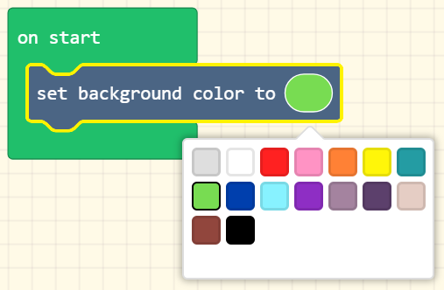
Set the background
From the Scene Toolbox drawer, drag a Set Background Color onto the Workspace
Drop into the On Start block
Select a background color

Slide 11
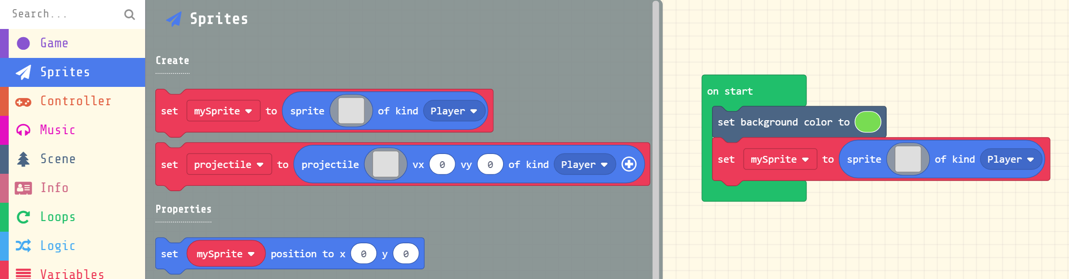
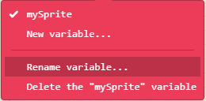
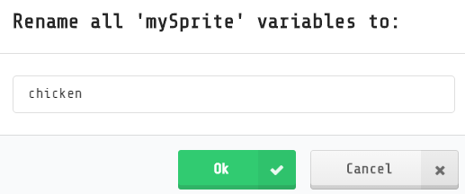
Create a Chicken Player Sprite
From the Sprites Toolbox drawer, drag a Set sprite block onto the Workspace
Drop into the On Start block after the Set Background block
Click on the mySprite drop-down menu and select Rename variable
Change the name to “chicken”

Slide 12
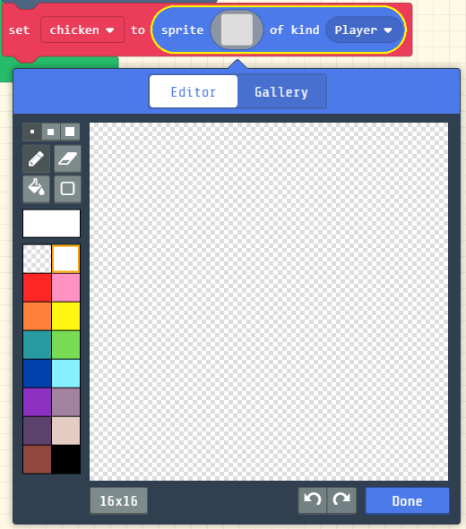
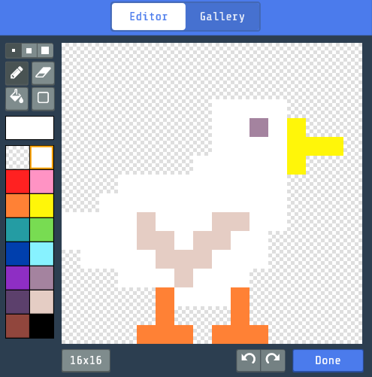
Design your Sprite
In the Sprite block, click on the empty Image
Design your own chicken image using the Image Editor
When done, click Done

Slide 13
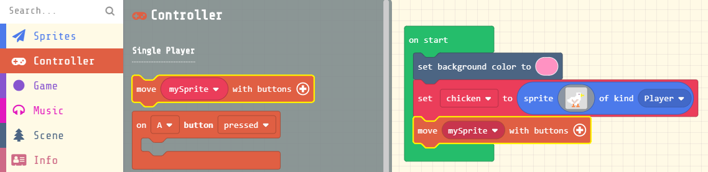
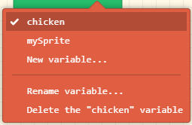
Control the movement of your Sprite
From the Controller Toolbox drawer, drag a Move block, and drop after the Set sprite block
In the Move block, click on the mySprite drop-down menu to select the chicken variable

Slide 14
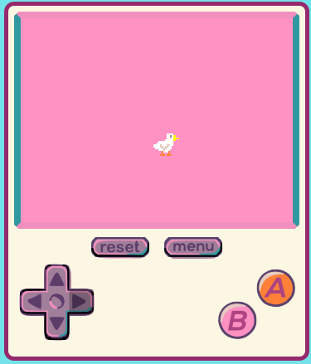
Try it out in Simulator
Click on the direction arrow buttons in the Simulator to move your Sprite around the screen
Or use the arrow keys on the keyboard (make sure the mouse is hovered over the Simulator to activate controls)

Slide 15
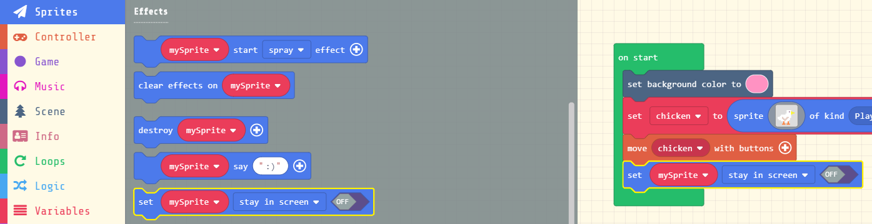
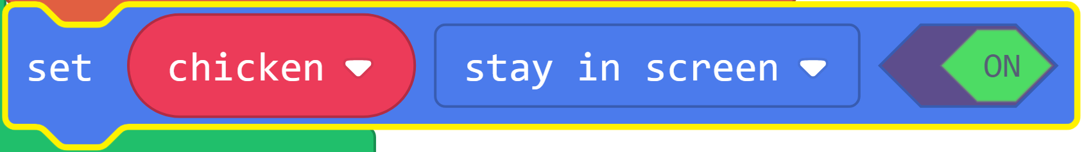
Stay in Screen
From the Sprites Toolbox drawer, under the Effects category, drag a Set sprite Stay in Screen block, and drop after the Move sprite block
In the Set sprite Stay in Screen block,
Select the chicken variable
Toggle the value to On

Slide 16
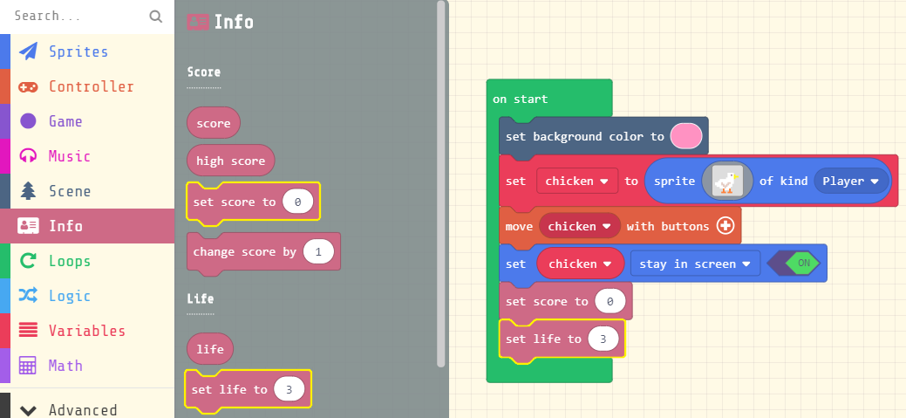
Initialize Life and Score
From the Info Toolbox drawer, drag a Set Score and a Set Life block, and drop after the Set sprite Stay in Screen block

Slide 17
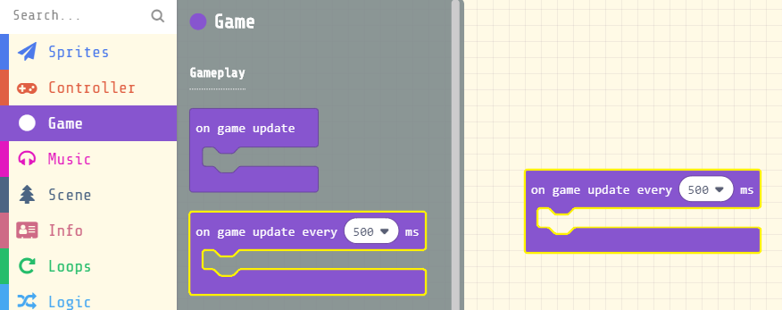
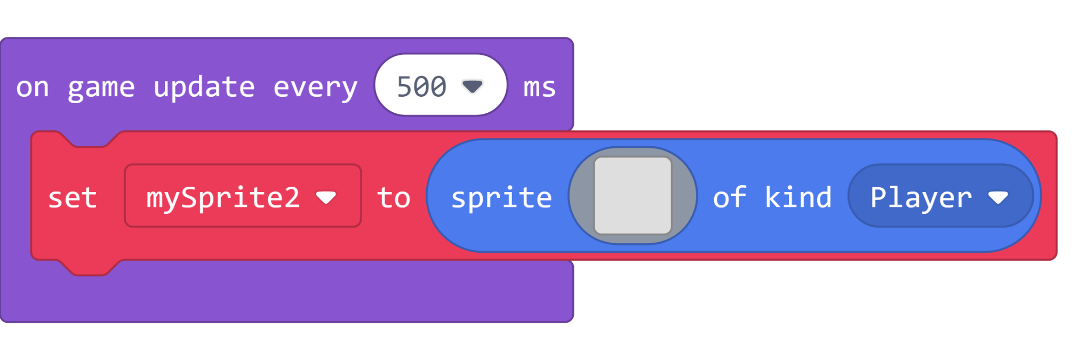
Create Car Enemy Sprites
From the Game Toolbox drawer, drag a On Game Update Every block onto the Workspace
From the Sprites Toolbox drawer, drag another Set sprite block, and drop into the On Game Update Every block

Slide 18
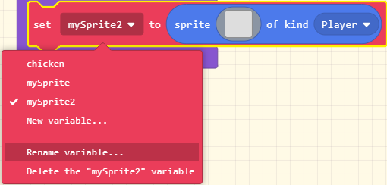
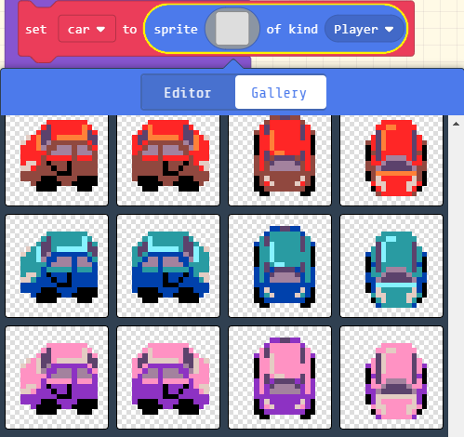
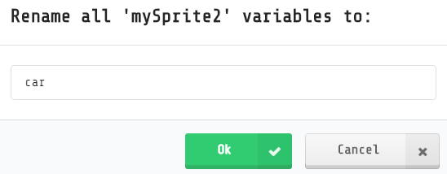
Create Car Enemy Sprites
In the Set sprite block, click the drop-down to rename mySprite2 variable to “car”
In the Sprite block, click on the empty Image
Click the Gallery and select a car image

Slide 19
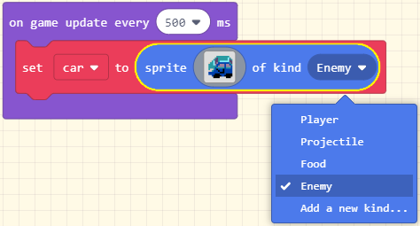
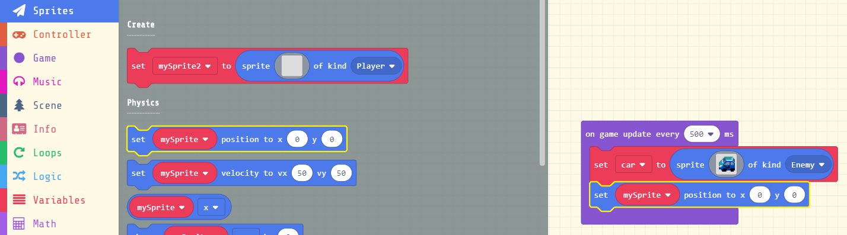
Set Car Enemy position
In the Sprite block, click the drop-down to select an Enemy sprite kind
From the Sprites Toolbox drawer, drag a Set Position block, and drop into the On Game Update Every block after the Set sprite block
Change to car variable

Slide 20
Arcade Console Coordinates
The Arcade game screen dimensions are 160 width x 120 height
0
(0, 0)
(160, 0)
Y
(0, 120)
(160, 120)
120
0
X
160

Slide 21
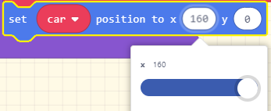
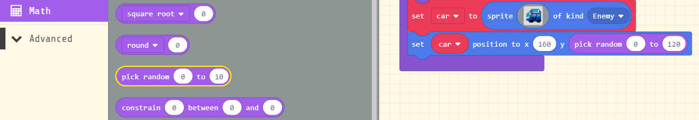
Set the position of the cars
Set the position of the cars to enter on the right side of the screen
X = 160
Set a random vertical position of the cars
Y = Random number between 0 and 120

Slide 22
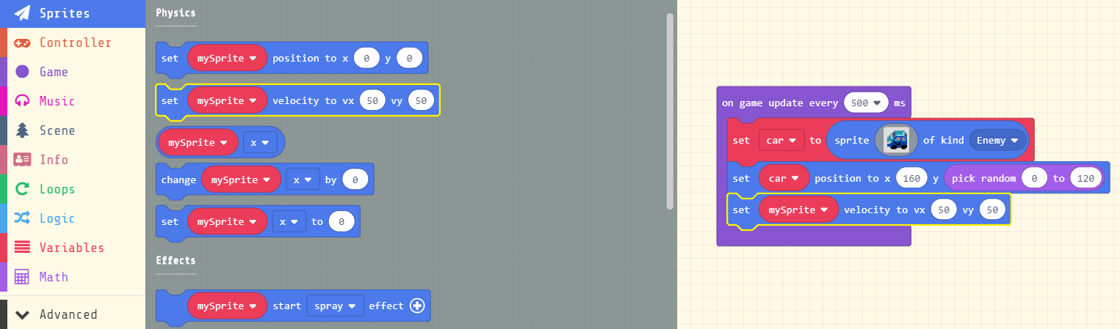
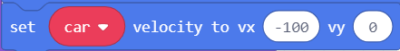
Set the speed and direction of the cars
From the Sprites Toolbox drawer, drag a Set Velocity block, and drop after the Set Position block
Change to car variable
Cars will be driving from right to left, so
Set vx = -100 and vy = 0

Slide 23
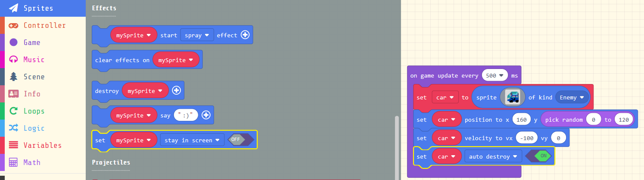
Set the cars to destroy themselves off screen
From the Sprites Toolbox drawer, under Effects, drag a Set Sprite flag block, and drop after the Set Velocity block
Change to car variable
Set to auto destroy
Turn On

Slide 24
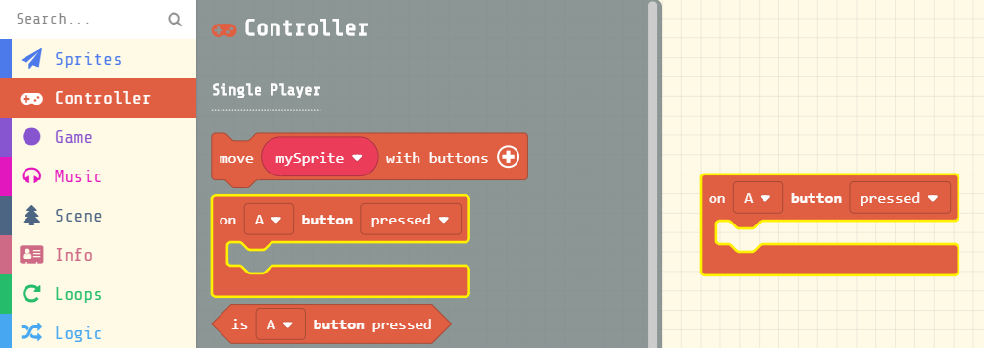
Spit seeds at the cars
From the Controller Toolbox drawer, drag a On A Button pressed block, and drop onto Workspace
From the Sprites Toolbox drawer, in the Projectiles category, drag a Set Projectile block into the On A Button pressed block

Slide 25
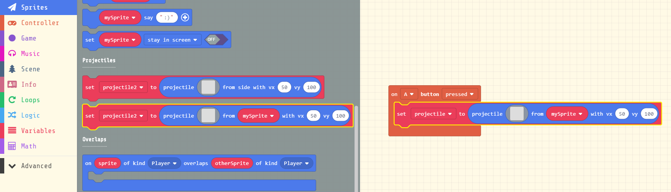
Spit seeds at the cars
From the Sprites Toolbox drawer, in the Projectiles category, drag a Set Projectile from Sprite block into the On A Button pressed block

Slide 26
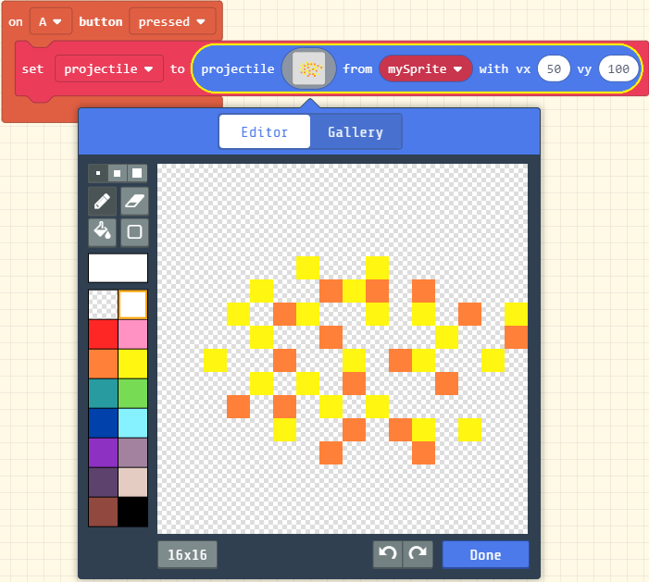
Design your seed projectiles
In the Projectile block, click on the empty Image
Design your own seed projectiles using the Image Editor
When done, click Done

Slide 27
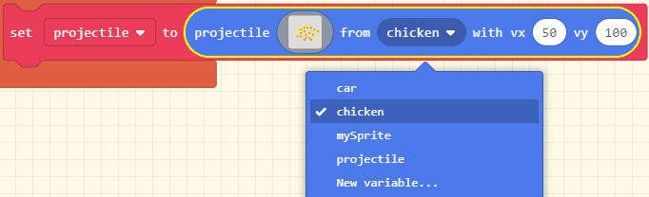
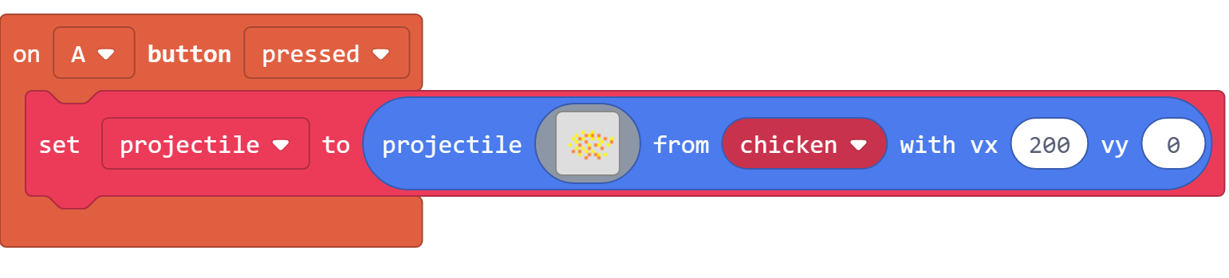
Set the speed and direction of seed projectiles
In the Projectile block, click on the variable drop-down menu to select chicken
Seeds will be shooting from the chicken, from left to right
Set vx = 200 and vy = 0

Slide 28
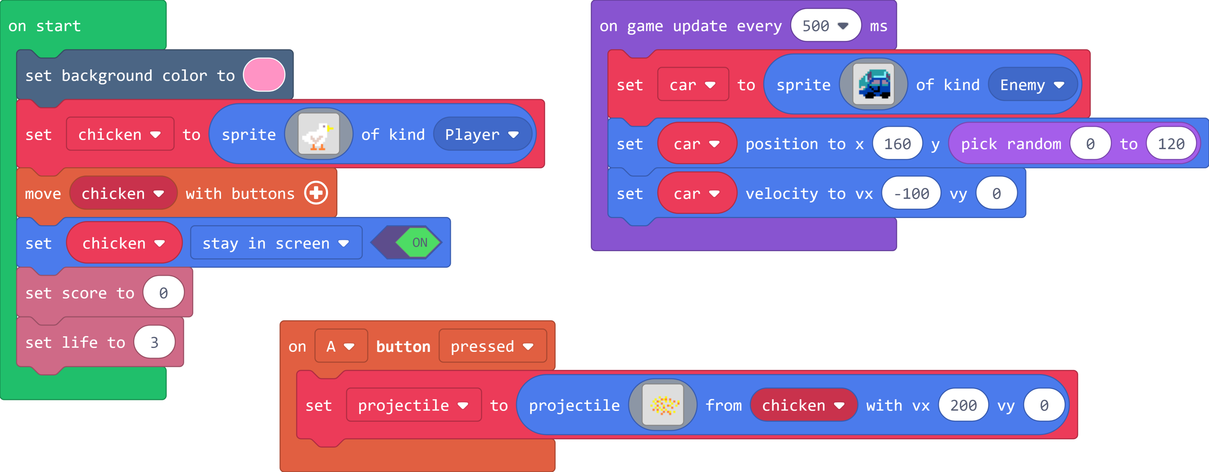
Code so far…

Slide 29
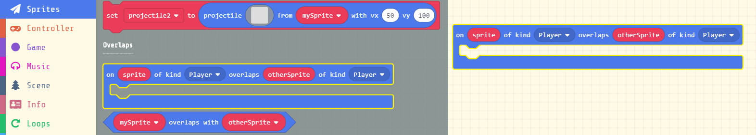
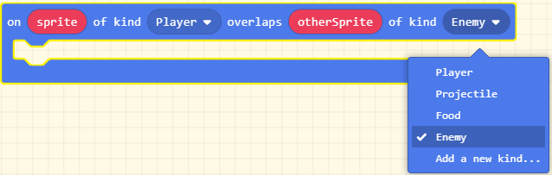
When the Chicken gets run over by a car
From the Sprites Toolbox drawer, in the Overlaps category, drag an On Sprite Overlaps block onto the Workspace
In the 2nd drop-down menu, change the sprite kind to Enemy

Slide 30
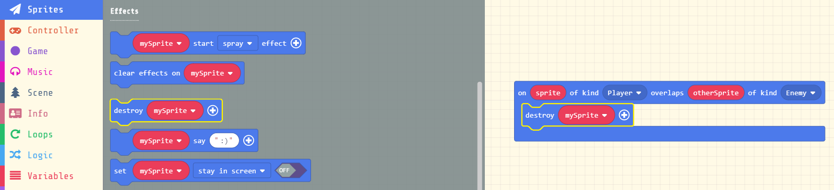
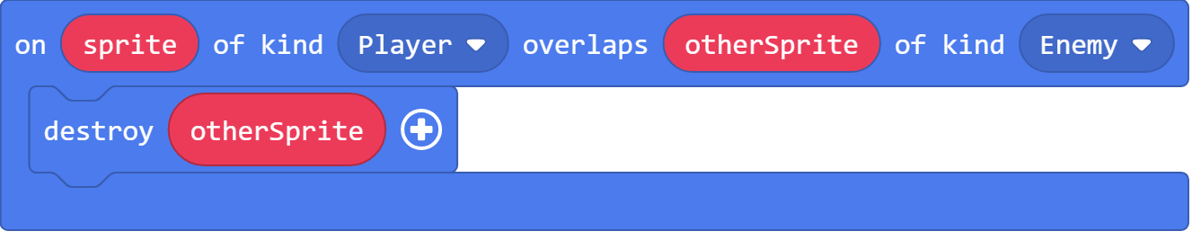
Destroy the car
From the Sprites Toolbox drawer, in the Effects category, drag a Destroy Sprite block into the On Sprite Overlaps block
In the On Sprite Overlaps block, drag the otherSprite variable into the Destroy Sprite block replacing mySprite

Slide 31


Add an Effect when car gets destroyed
In the Destroy Sprite block, click the plus (+) sign to expand
Click the drop-down menu to select an Effect
Change the duration to 100 milliseconds

Slide 32

Add a camera shake when chicken gets hit
From the Scene Toolbox drawer, under the Camera category, drag a Camera Shake block into the On Sprite Overlaps block after the Destroy Sprite block

Slide 33


Add a sound when chicken gets hit
From the Music Toolbox drawer, drag a Play Sound block after the Camera Shake block
Use the drop-down menu to select a sound to play

Slide 34

Decrement Chicken’s Life
From the Info Toolbox drawer, drag a Change Life by -1 block after the Play Sound block

Slide 35


When Seeds hit a car
Right-click on the On Sprite Overlaps block in the Workspace, and select Duplicate
In the 2nd On Sprite Overlaps block, click on the 1st drop-down menu to change the sprite kind to Projectile

Slide 36


Change the car destroyed Effect
In the Destroy Sprite block, select a different Effect
Delete the Camera Shake block by selecting it and pressing the delete key on your keyboard, or right-clicking and selecting Delete Block

Slide 37


Destroy the Seeds
From the Sprites Toolbox drawer, drag another Destroy Sprite block and drop after the first Destroy Sprite block
From the On Sprite Overlap block, drag the Sprite variable block into the 2nd Destroy Sprite block replacing the mySprite variable

Slide 38


Change the sound
In the Play Sound block, select a different sound effect
Delete the Change Life block

Slide 39

Increment the Score
From the Info Toolbox drawer, drag a Change Score block after the Play Sound block

Slide 40

Two Overlap Events

Slide 41

Notes:
https://makecode.com/_VxzA0c67K2pE

Slide 42




Share your Game
Name your Game
Click the Share button in the top left
Click the Publish Project button
Copy the URL somewhere

Slide 43



Download to Hardware!
arcade.makecode.com/hardware

Slide 44
Stay Involved
Forum – forum.makecode.com
Bugs, Suggestions – aka.ms/arcadebugs
Curriculum – arcade.makecode.com/courses

Slide 45

MakeCode Arcade
Please fill out Survey! – aka.ms/SurveyAR
More about MakeCode – makecode.com
MakeCode Arcade – arcade.makecode.com

